Slide 1

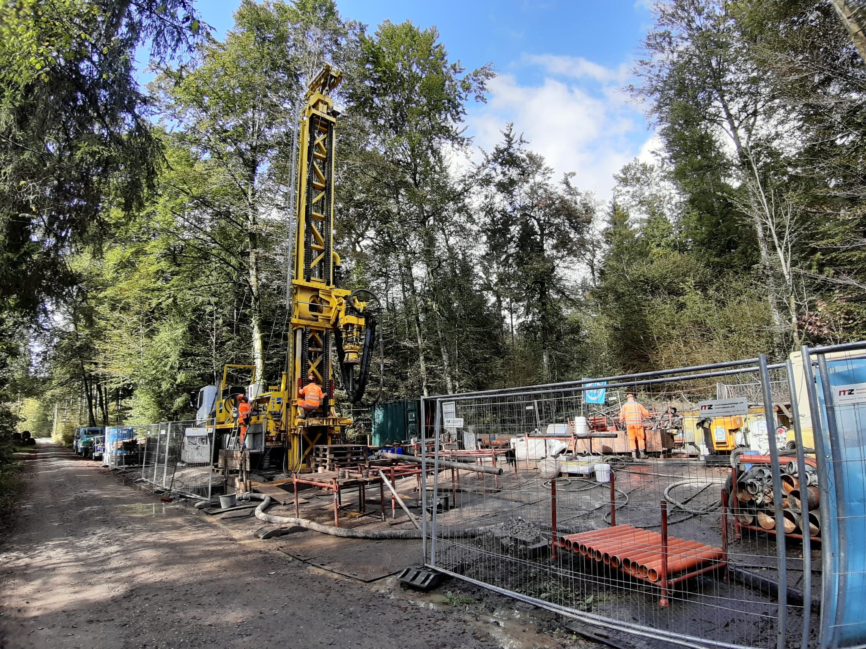


Image-based Classification of Sediments in Drill Cores
ADS CAS Final Project
10.08.2025
Patricio Becerra and Sebastian Schaller

Slide 2
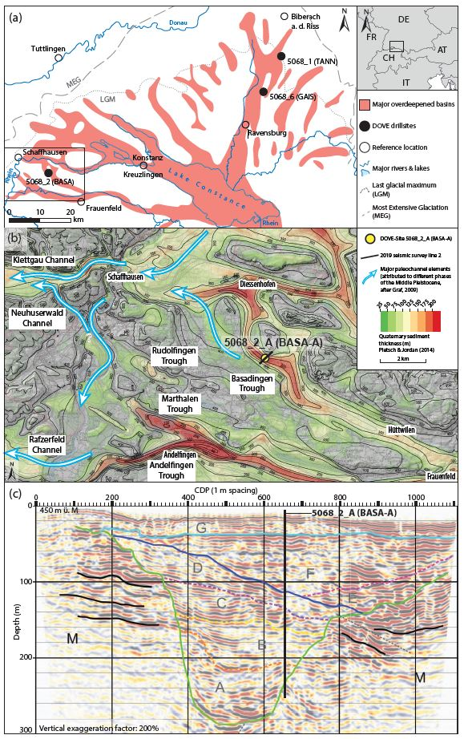
Introduction and background
Glacial extents of the Rhine Glacier
Seismic line
Local overdeepenings
Drill core

Slide 3
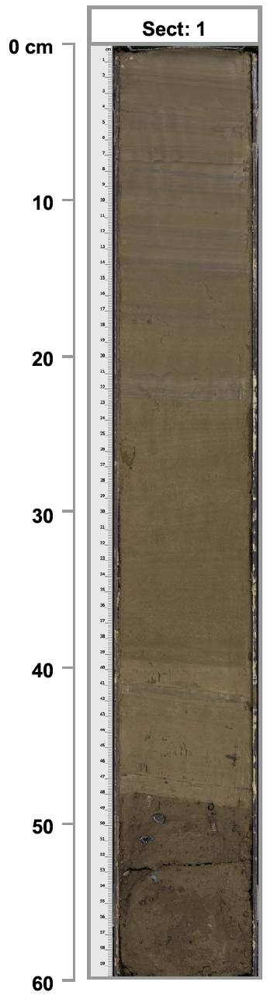
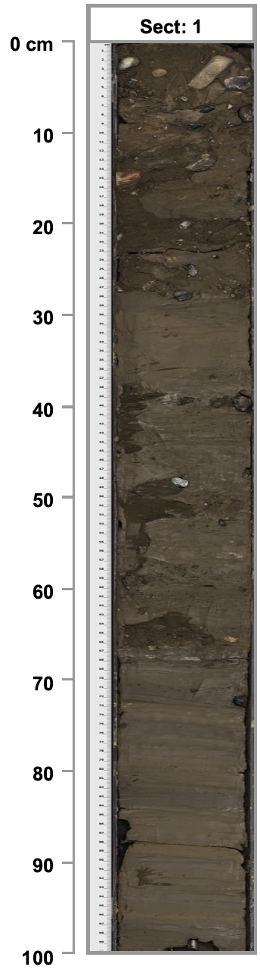
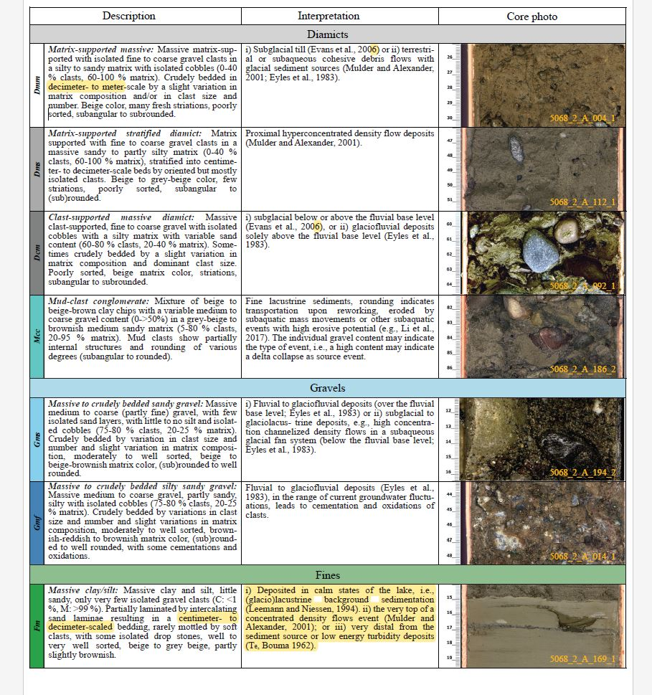
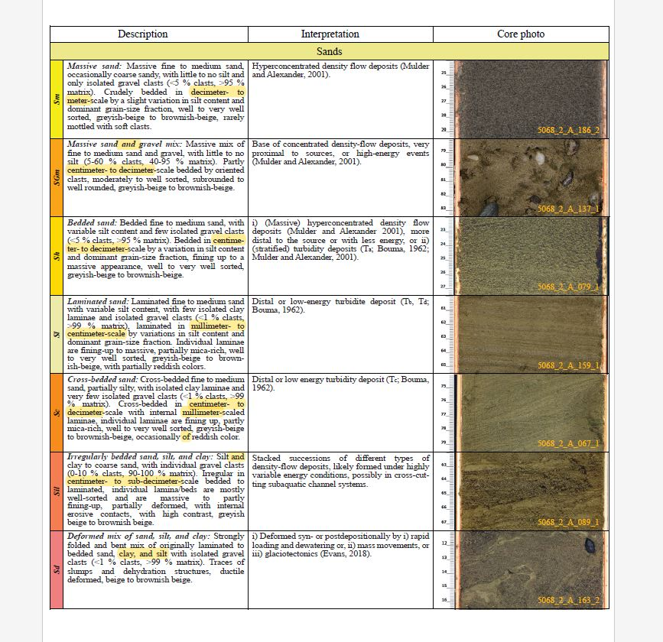
Introduction and background
High-resolution scanned images of sediment drill cores were used to classify the unconsolidated sediments into several lithoclastic types (e.g. gravel, sand, or fine clays)
The goal of our Module 6 project was to set the foundation for a deep learning model that can classify the sediments in a drill core image of unconsolidated quaternary sediments → Image segmentation
The full model is Patricio’s half of our CAS project (the other half was presented by Sebastian and published)
Diamict
Gravel
Advantages:
Visual litho-classification takes months
Optimizes the development of stratigraphic models
Sand
Fines

Slide 4
Project Tasks & Objectives
Create training, test and validation datasets from a subset of the previously visually litho-classified images
Label the image data → i.e. manually create image segmentation masks for the selected subset of previously classified images
Write a basic model based on similar image segmentation models in the literature [e.g. DiMartino et al., 2023]
Evaluate initial results and indicate likely future steps

Slide 5
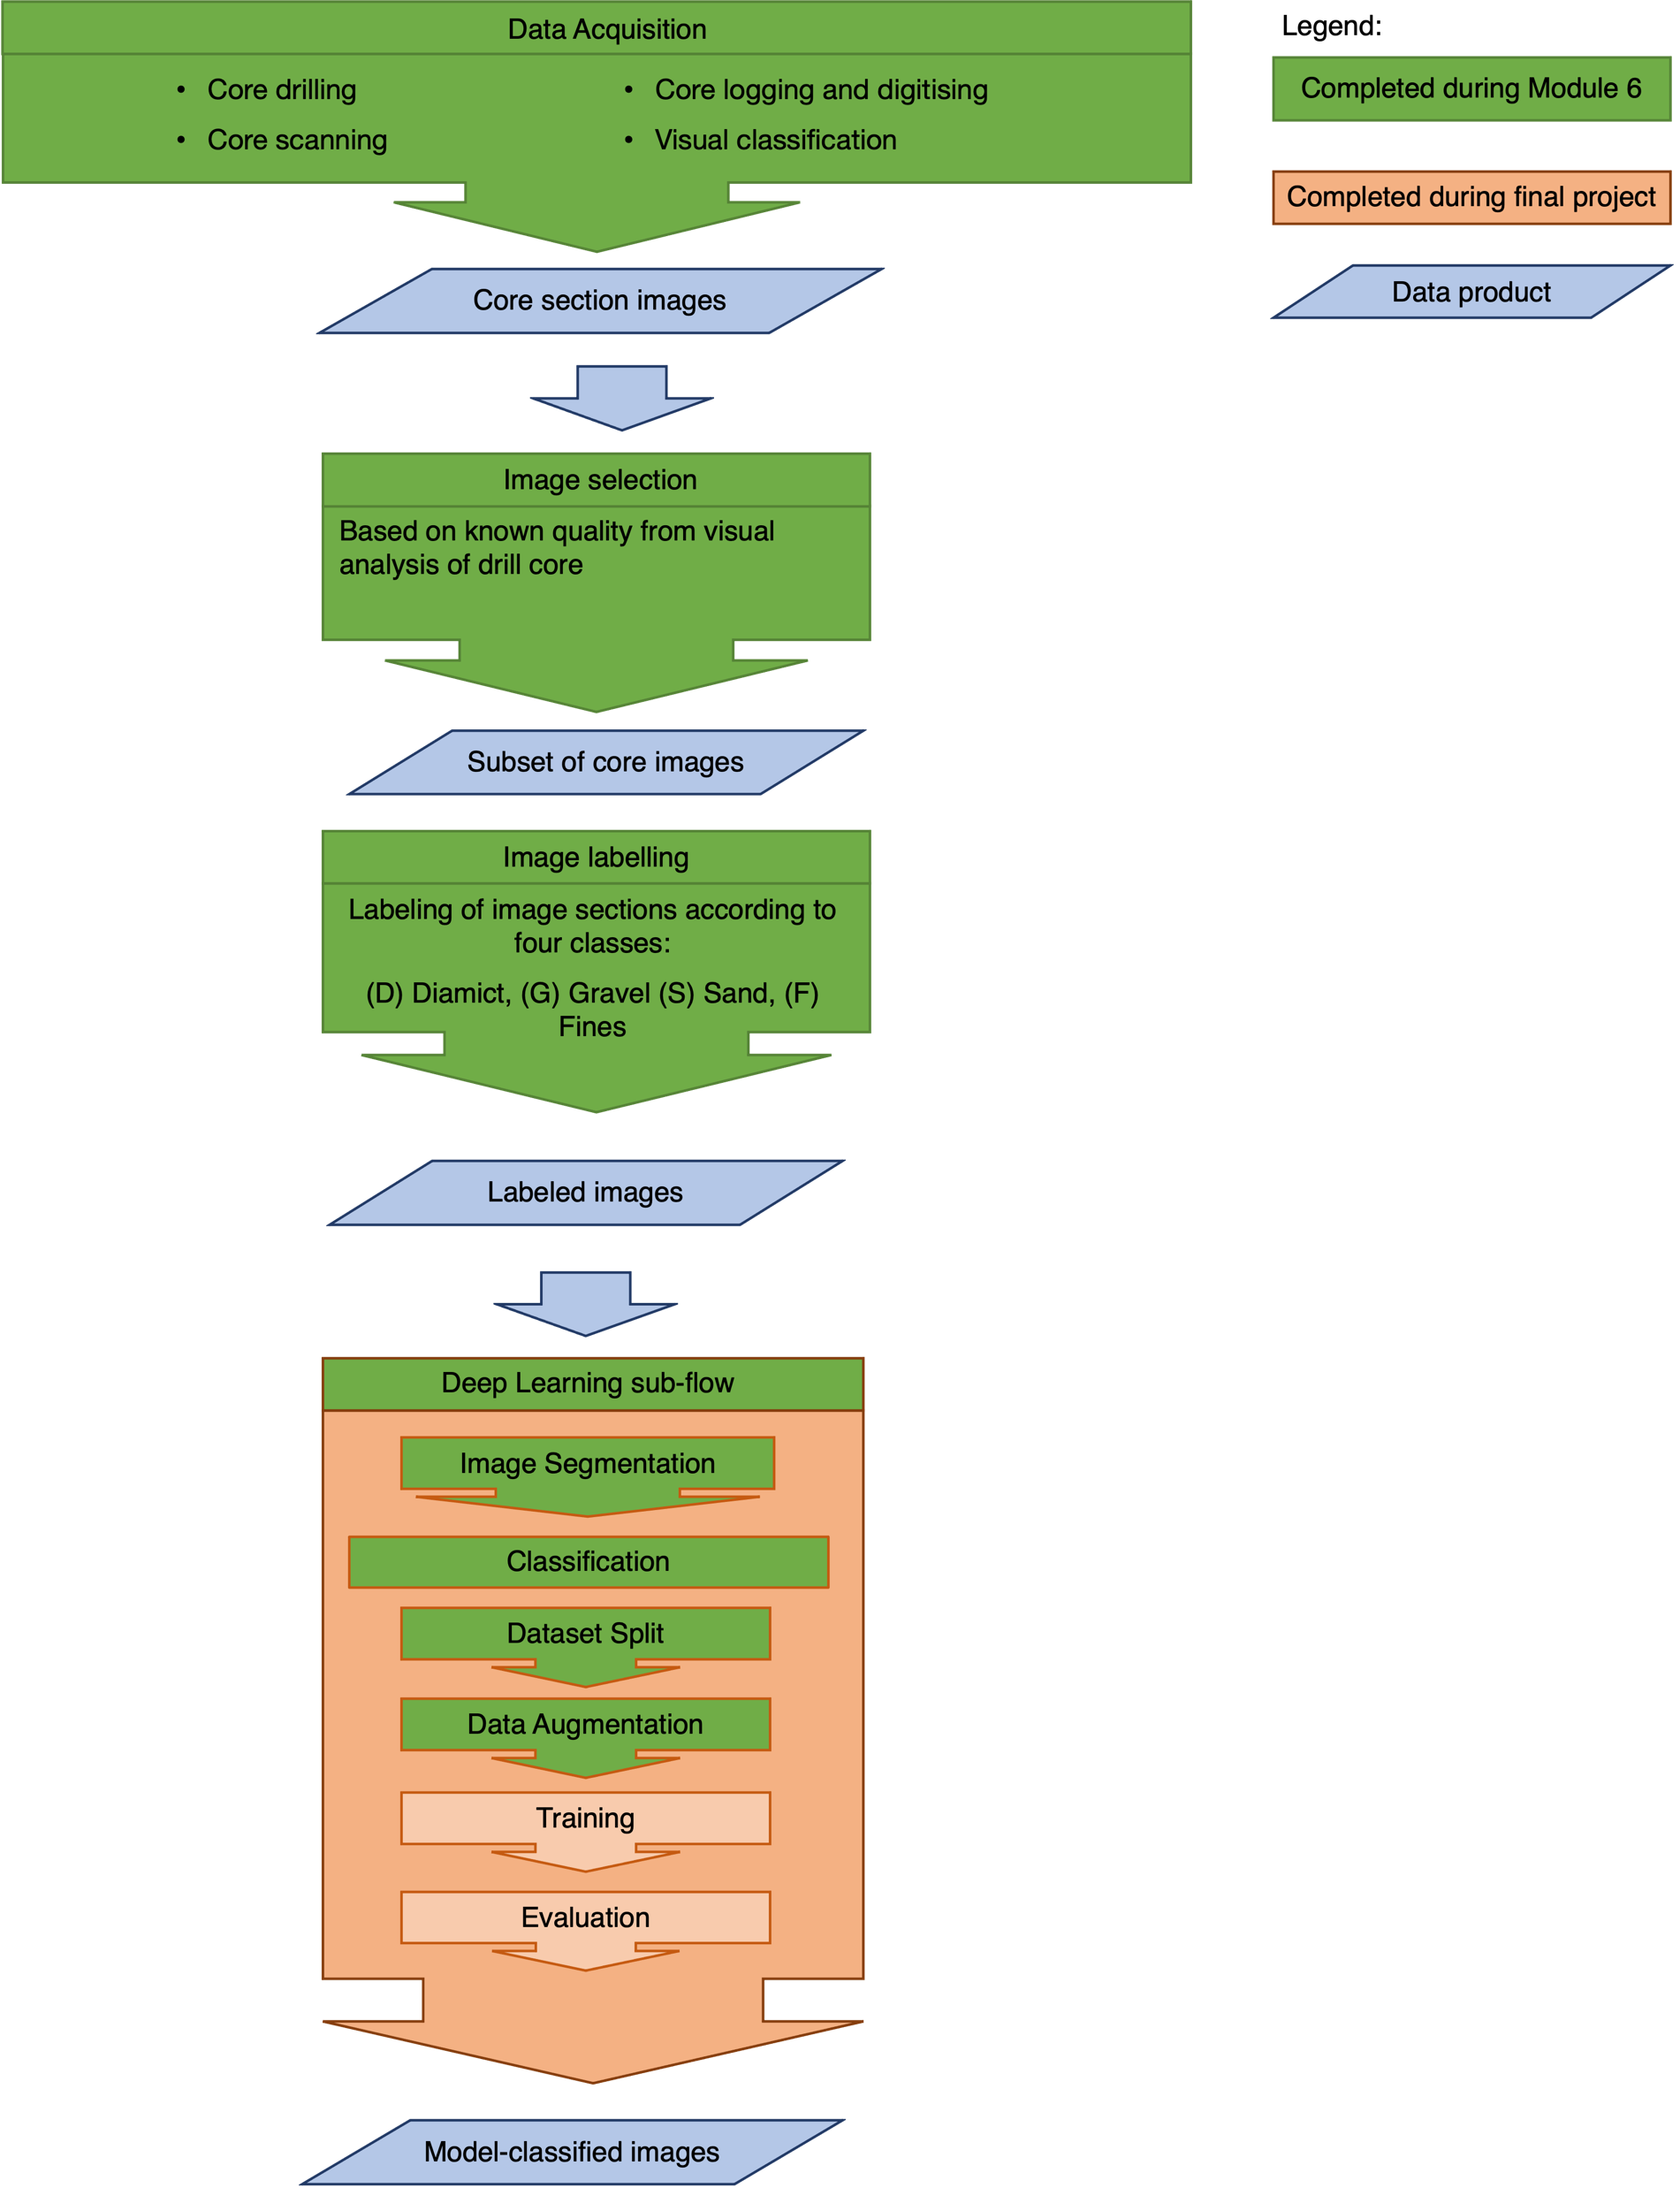
Data flow
Several steps of the workflow were completed during the CAS modules
The initially envisioned final project goal (The construction of image and data-based stratigraphic columns to cross-correlate with each other and with the visual-based stratigraphic column) was unfortunately not achievable in the timeframe
Nevertheless, the classification of images by the deep learning model was achieved with an acceptable degree of accuracy and success.

Slide 6
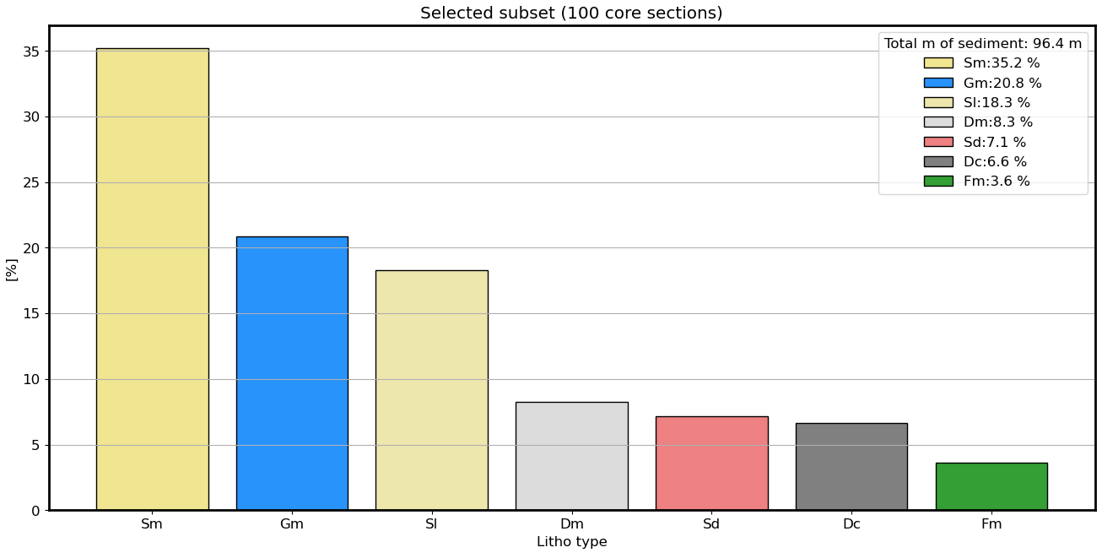
Dataset selection

Slide 7
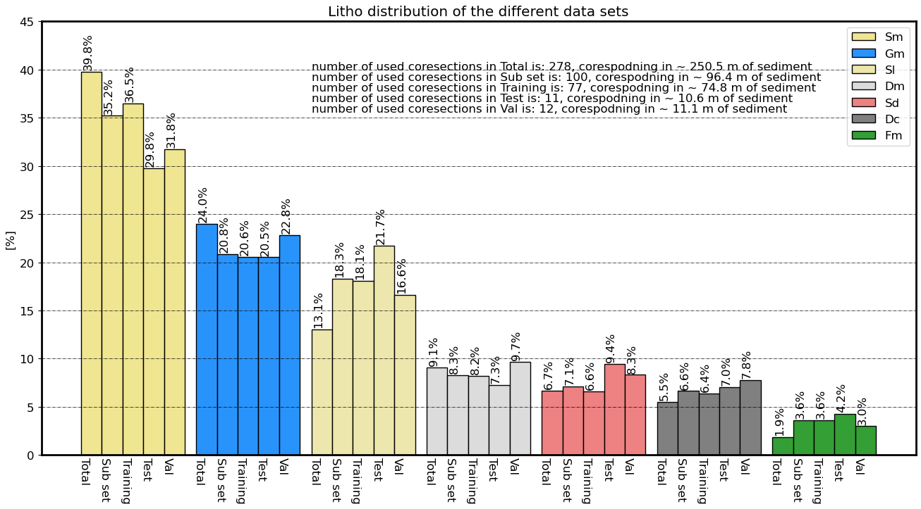
Dataset selection

Slide 8
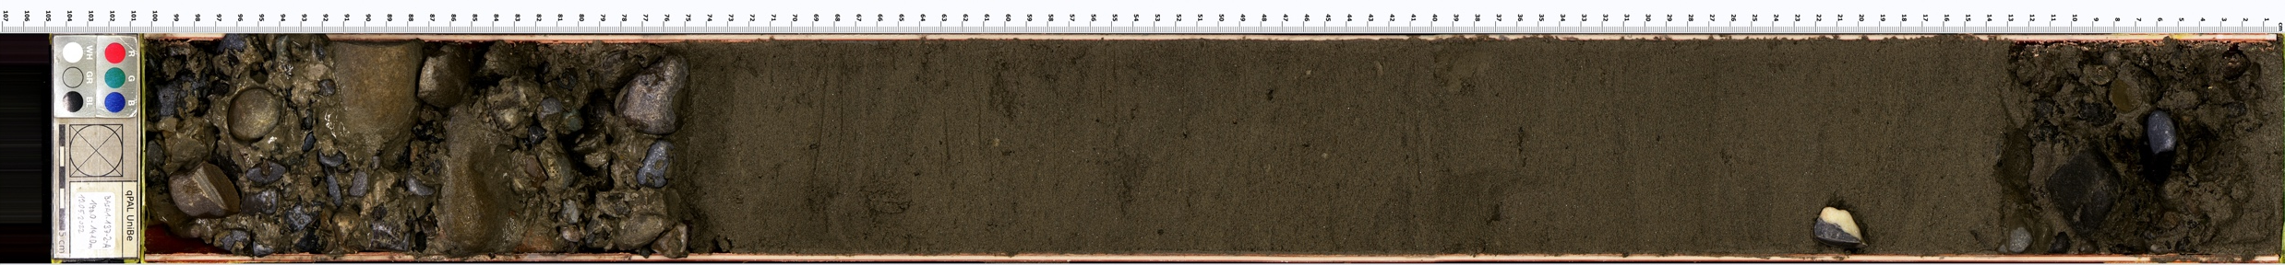

Data labeling: Manual image segmentation
Creating image masks
Massive Gravel
Massive Gravel
Laminated Sand

Slide 9
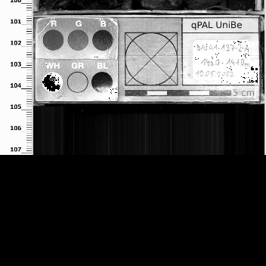
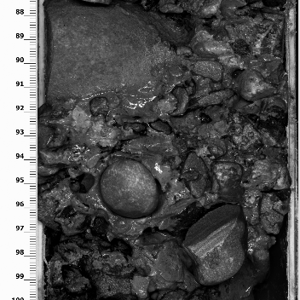
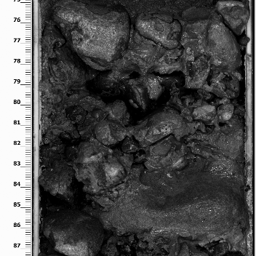
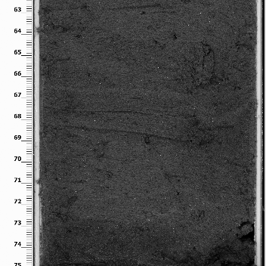
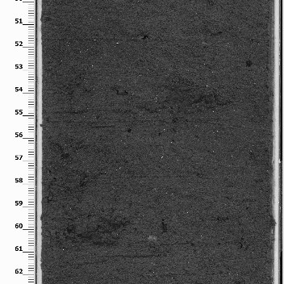
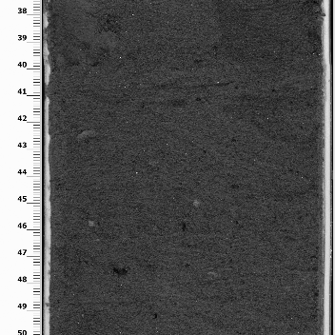
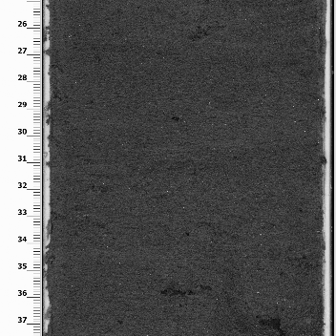
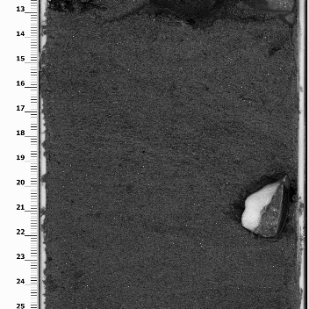
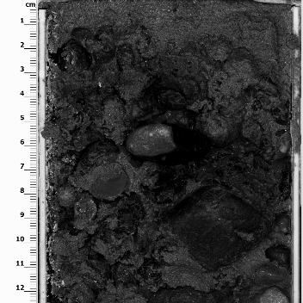





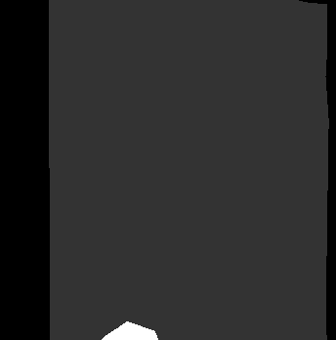
Data Processing: Image splitting
Massive Gravel
Massive Gravel
Laminated Sand

Slide 10
Deep-learning model
Model architecture: U-Net (Tensorflow). Selected based on DiMartino et al., 2023
Used tutorial model: https://youtu.be/XyX5HNuv-xE?si=ywxtReVqf1nxxlzZ
Number of classes:
8 classes: First attempt during M6. Further runs improved during final project.
5 classes: Improving classification accuracy by reduing the number of classes through knowledge-based grouping of the existing classes
Optimizer: Adam
Loss functions attempted: Categorical cross-entropy; Focal loss
Datasets:
77 images for training, split into square sections of 352x352 → 672 sections for training
Used train_test_split
Additionally had set of 12 images, i.e., 100 sections for validation
Tested several epochs and batch sizes

Slide 11
Summary of model runs
The model was first run and trained with the original 8 classes on the training set (77 full images → 672 square image sections)
The best model found ended up using random splitting of test and train subsets (train_test_split) within the training set of images, 40 epochs, 10 batches, and a categorical_crossentropy loss function
The model was saved and then ran on the validation set of images (12 full images → 100 sections)
The model was then run and trained again but using only 5 classes
The other parameters remained the same (random splitting of test and train subsets within the training set of images, 40 epochs, 10 batches, and a categorical_crossentropy loss function)
The model was saved and then ran on the validation set of images (12 full images → 100 sections)
Summary of results in the following slides

Slide 12
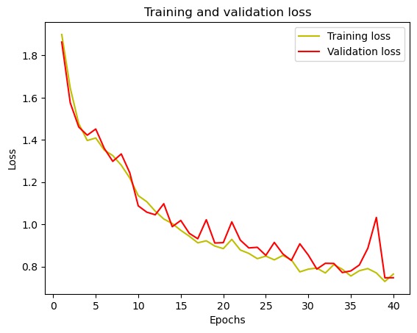
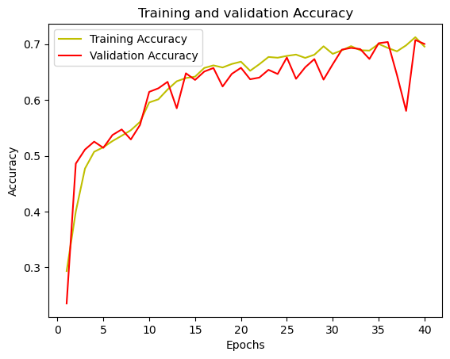
Results: 8 classes.
Best model: Random splitting, 40 epochs, 10 batches, categorical_crossentropy
Notes:
Patricio (30 sec): Increase epoch number (hyperparameter tuning). nnUNet.

Slide 13
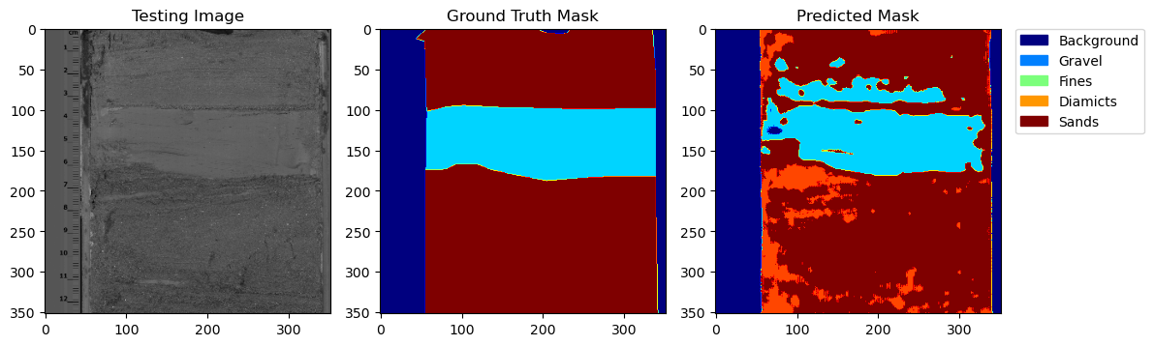
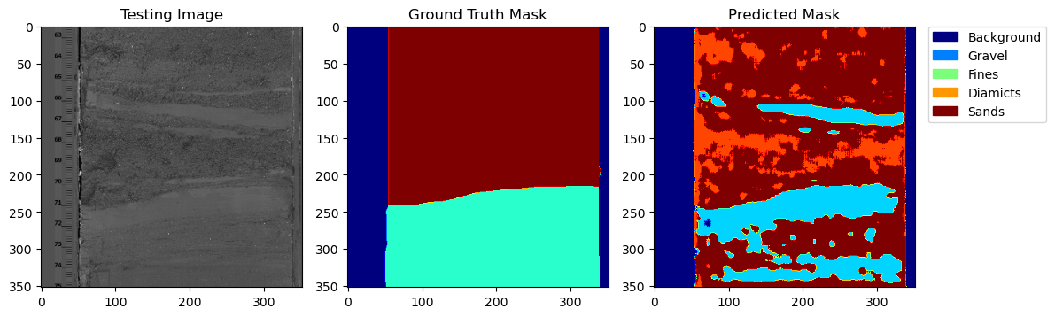
Results: 8 classes. Training Set
Sample image results
Validation selected through train_test_split
ImId: 20
Good classification
Accuracy is: 70.04%
Mean IoU is: 0.46
IoU of class 0 is: 0.8902197
IoU of class 1 is: 0.7094859
IoU of class 2 is: 0.4088437
IoU of class 3 is: 0.2409902
IoU of class 4 is: 0.6543245
IoU of class 5 is: 0.5121779
IoU of class 6 is: 0.26509157
IoU of class 7 is: 3.5232415e-06
ImId: 38
Bad classification

Slide 14
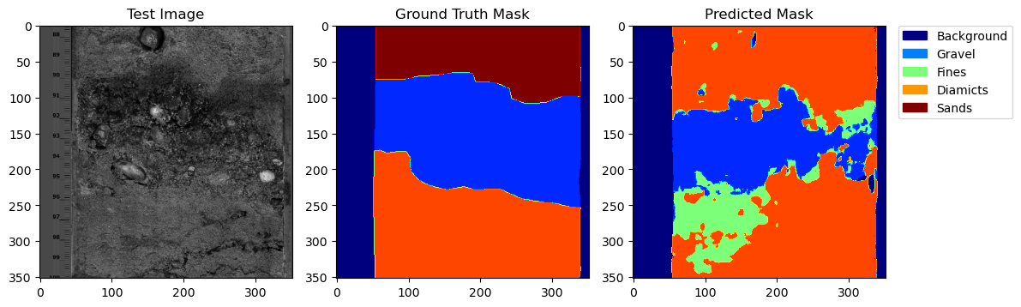
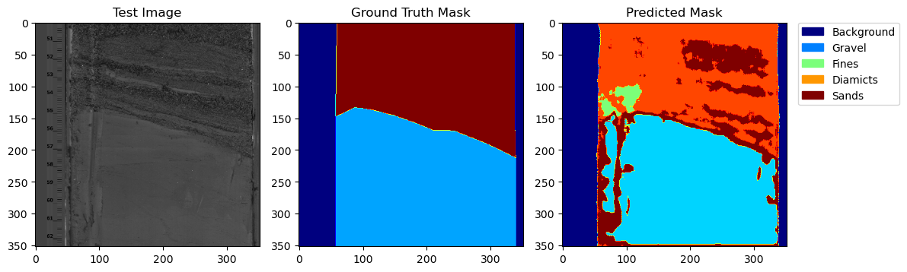
Results: 8 classes. Validation set
Sample image results
Manually selected validation set.
Not part of training set
ImId: 39
Validation Accuracy: 69.66% Mean IoU = 0.4170231
IoU of class 0 is: 0.9467
IoU of class 1 is: 0.6159
IoU of class 2 is: 0.6125
IoU of class 3 is: 0.1718
IoU of class 4 is: 0.2560
IoU of class 5 is: 0.4906
IoU of class 6 is: 0.2426
IoU of class 7 is: 0.0000
ImId: 81

Slide 15
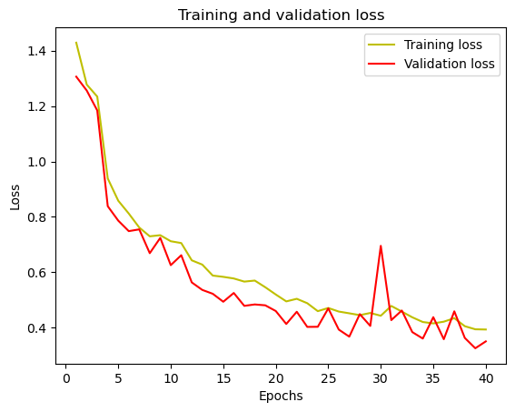
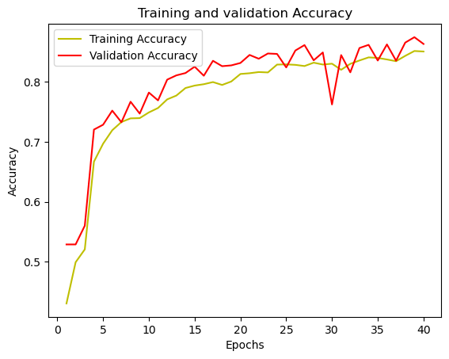
Results: 5 classes
The 8 original classes were re-mapped as follows:
0 = Background
1 = Gravel
2 = Fines
3, 4 = 3 = Diamicts
5, 6, 7 = 4 = Sands
Other parameters remained the same as above:
Random splitting, 40 epochs, 10 batches, categorical_crossentropy

Slide 16
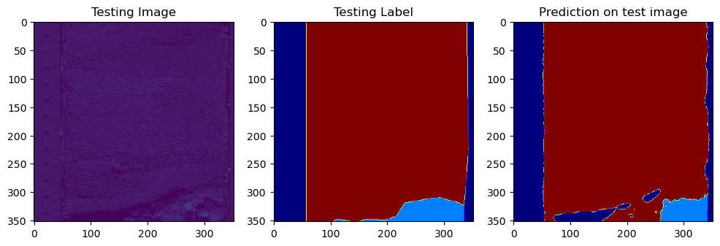
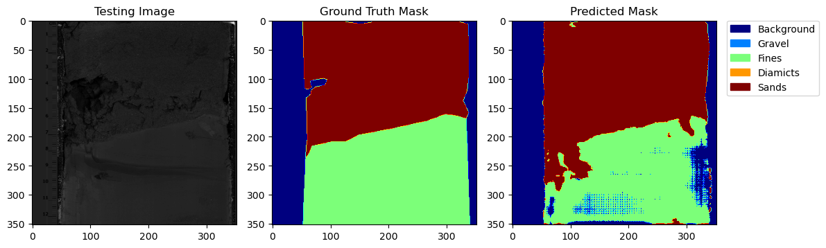
Results: 5 classes. Training Set
Accuracy is: 86.3%
Mean IoU is: 0.612
iou of class 0 is: 0.8946793
iou of class 1 is: 0.5899338
iou of class 2 is: 0.49658573
iou of class 3 is: 0.18805782
iou of class 4 is: 0.89107263
ImId: 51
Notes:
re-run model4 on the training set with train_test_split to get a better plot of the first figure here.

Slide 17
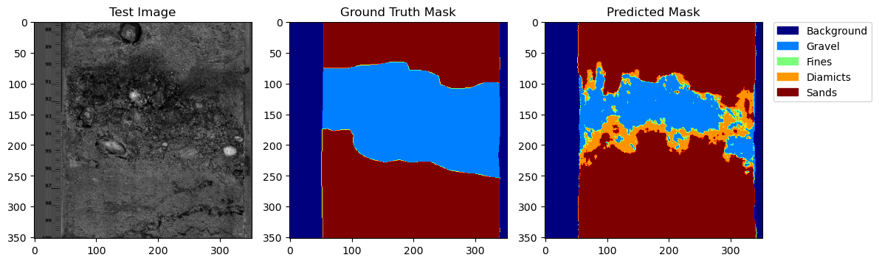
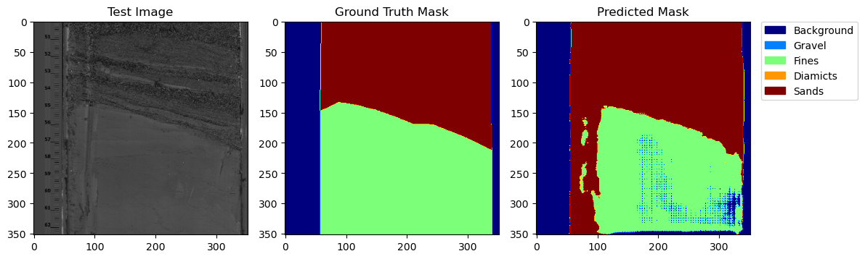
Example results (5 classes – Validation set)
ImId: 39
Validation Accuracy: 82.03% Mean IoU = 0.61467546
ImId: 81
IoU of class 0 is: 0.9474
IoU of class 1 is: 0.5719
IoU of class 2 is: 0.6719
IoU of class 3 is: 0.1048
IoU of class 4 is: 0.7775

Slide 18
Conclusions
The basic model constructed achieves its desired objective of classifying lithologies within stratigraphic images with an acceptable degree of accuracy
There is a noticeable improvement when reducing the number of classes for classification from 8 to 5.
The model seems to be especially good at classifying sands and fines, and has a harder time classifying gravel or diamicts in a way consistent with the human-led classification
However, this could be used as an advantage, as in many images, the model identified large boulders within a gravel section as diamicts, when the visual classification had simply classified the whole section as gravel → this differentiation could be harnessed to explore a more detailed classification or to identify the presence of clasts over a certain size threshold
Notes:
Patricio (30 sec)

Slide 19
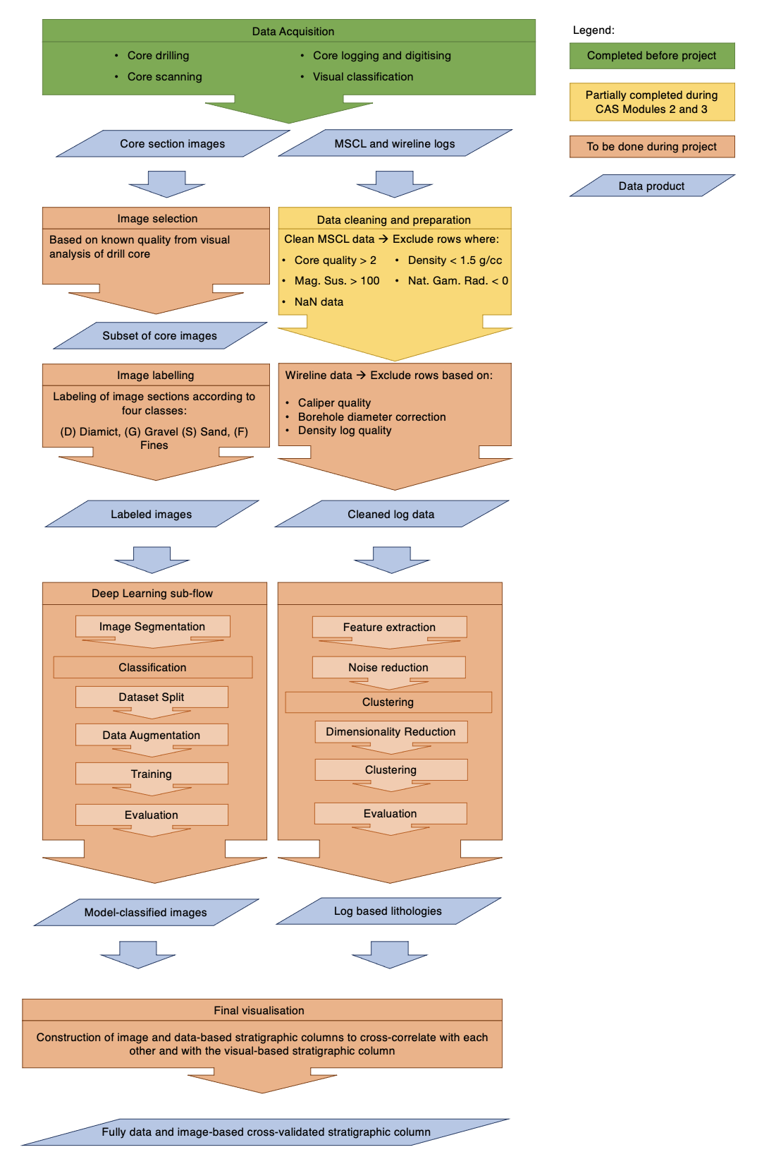
Steps to take the project further
Increase training dataset (up to 1000 images available)
Improve Deep Learning toolset : Tensorflow → Pytorch
Try U-Net pre-trained on ImageNet with various backbones (e.g. EfficientNet)
Data augmentation
Notes:
Patricio (30 sec)

